Slide 1
3D Scanning
Sparks Lu
Last updated: 10-8-2021

Slide 2
Change History
10/8/2021
Added indoor scanning

Slide 3
Type
Contact
Non-contact active
laser
TOF (time of flight)
triangulation
structured light
Non-contact passive
stereoscopic
photometric

Slide 4
Comparison

Slide 5
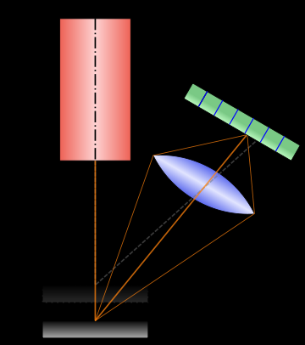
Range Scanner
Theory
Laser triangulation
Not good at
shiny
low surface albedo
significant subsurface scattering

Slide 6
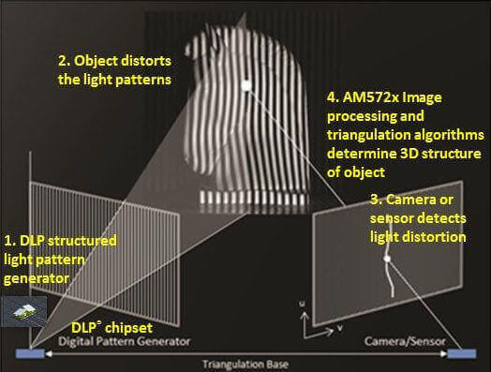
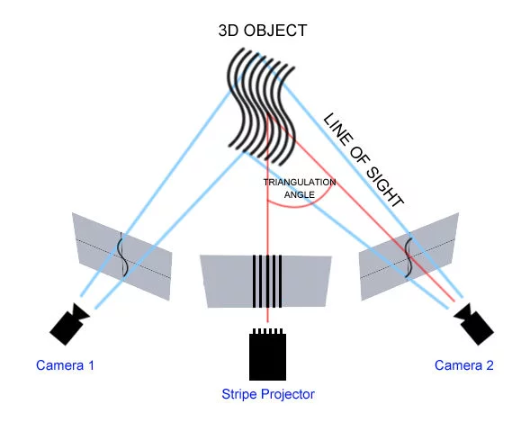
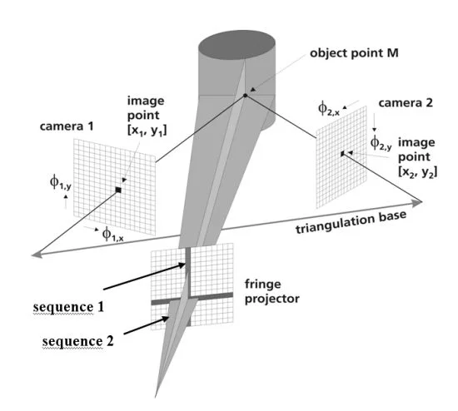
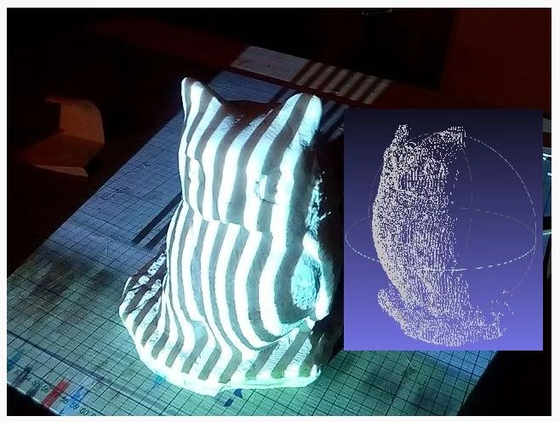
Structured-light 3D Scanner
Theory
consists of IR projector and IR sensor
Applications
PrimeSense
early version of Microsoft Kinect
Occipital Structure Sensor
Intel RealSense
Face ID: projecting more than 30K infrared dots
Not good at
reflective surface
transparent or semi-transparent surface
sub-surface scattering, such as skin, marble, wax, plants and human tissue
concave surface

Slide 7
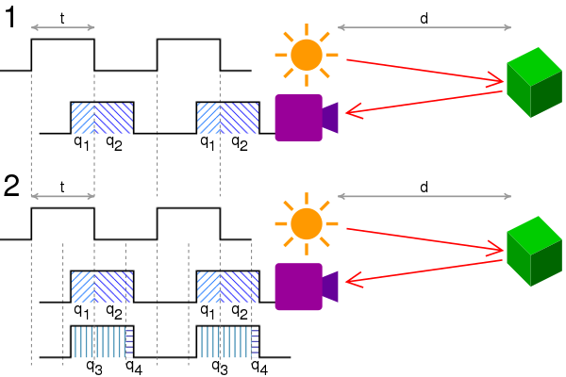
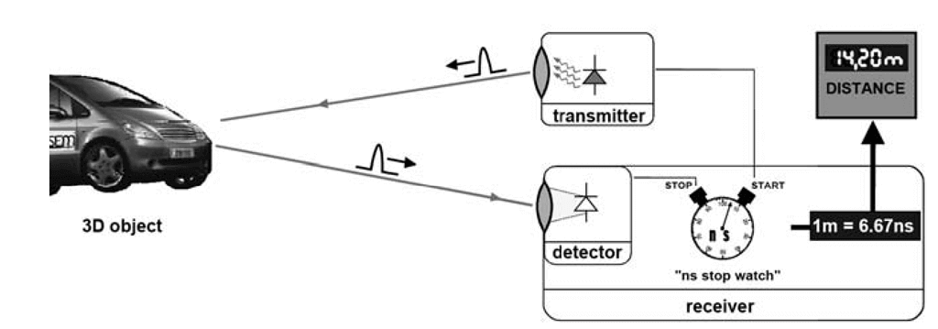
Time of Flight Camera
Disadvantages
background light
interference
multiple reflections
Application
Microsoft Kinect 2nd generation

Slide 8
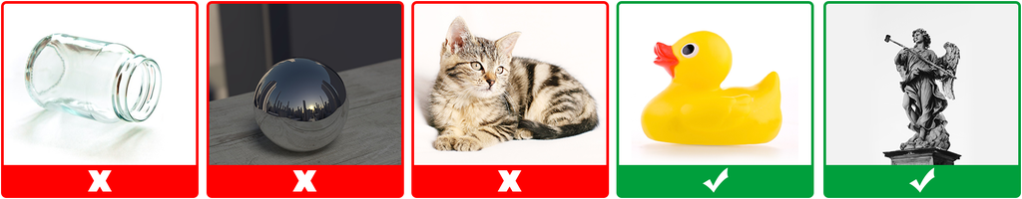
Photogrammetry
Reference
https://www.instructables.com/3D-Scan-Anything-Using-a-Camera-Photogrammetry-Wit/
Not suitable
Moving object
Having micro details, like leafy plants, hair and fur
Reflective
Transparent, translucent and untextured objects

Slide 9
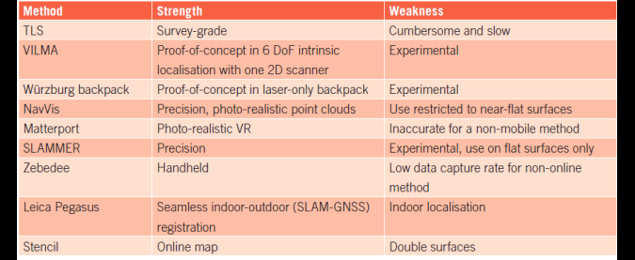
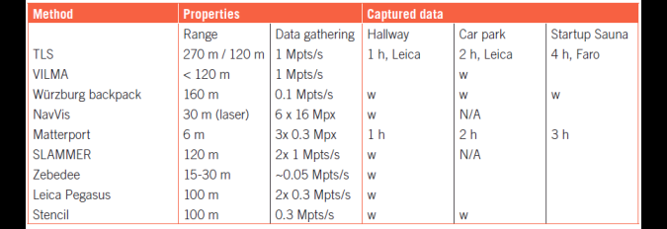
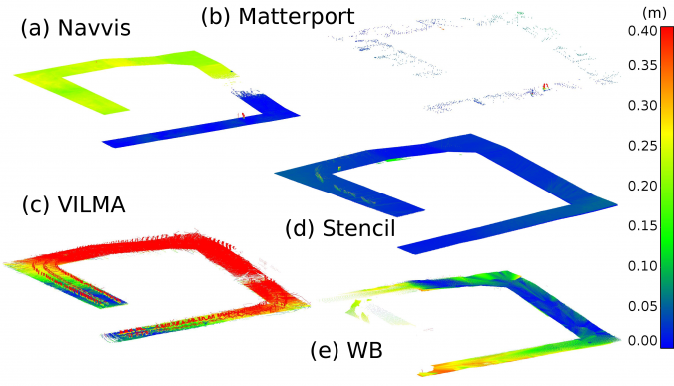
Indoor Scanning 1/2
References
https://www.gim-international.com/content/article/autonomous-3d-modelling-of-indoor-spaces
https://acris.aalto.fi/ws/portalfiles/portal/17017659/remotesensing_09_00796_v2.pdf

Slide 10
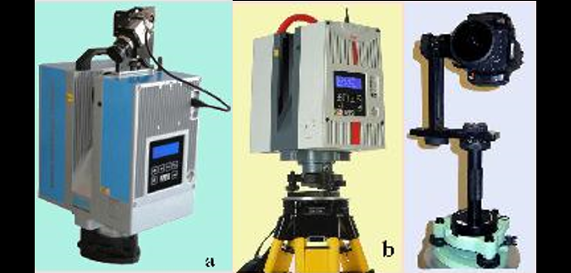
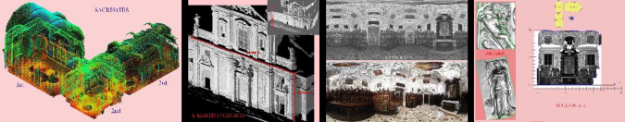
TLS (Terrestrial Laser Scanning)
References
https://www.gim-international.com/content/article/terrestrial-laser-scanning-2
https://f.hubspotusercontent40.net/hubfs/3339696/State%20of%20Mobile%20Mapping%202021.pdf?hsCtaTracking=2cf01e48-9803-4273-a9cb-28a5a72bfb88%7C1003557b-fe59-47bb-a928-e17d0470e054

Slide 11
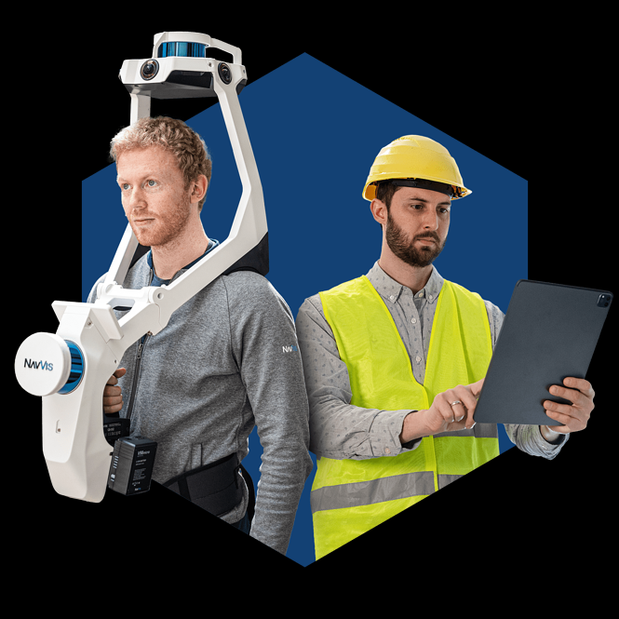
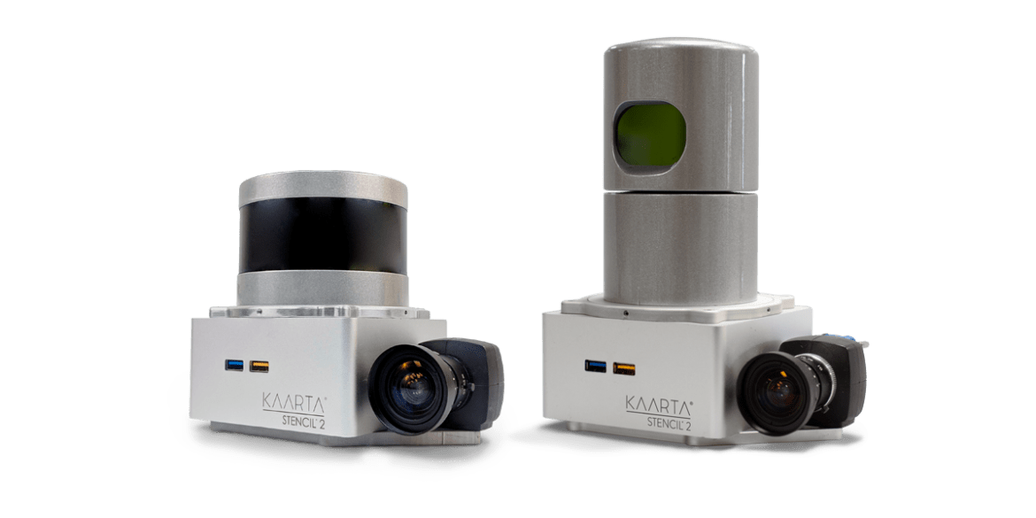
MLS (Mobile Laser Scanning) 1/2
Matterport
https://matterport.com/
2D sensors capture HDR images
3D sensors capture depth data
NavVis
https://www.navvis.com/
6 16MP cameras
3 laser scanners with a 30m range
installed on a trolley chassis
postprocessing: point cloud processing, web processing
Zebedee
handheld 3D mapping system
a lightweight laser scanner with a 15-30m max range
an industrial-grade IMU
Stencil
https://www.kaarta.com/
Velodyne VLP-16
a low-cost MEMS IMU
Leica Pegasus: Backpack
https://leica-geosystems.com/
two Velodyne VLP-16
NovAtel IGM-S1 for GNSS-IMU positioning
Stencil2
NavVis

Slide 12
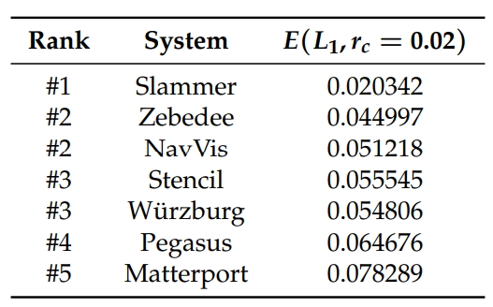
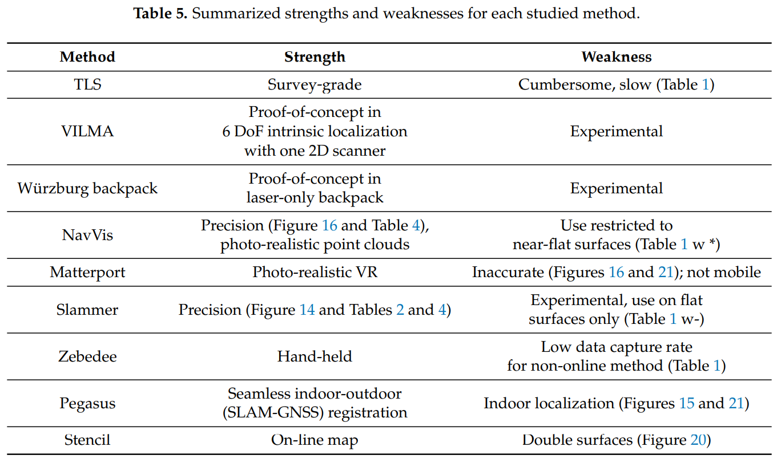
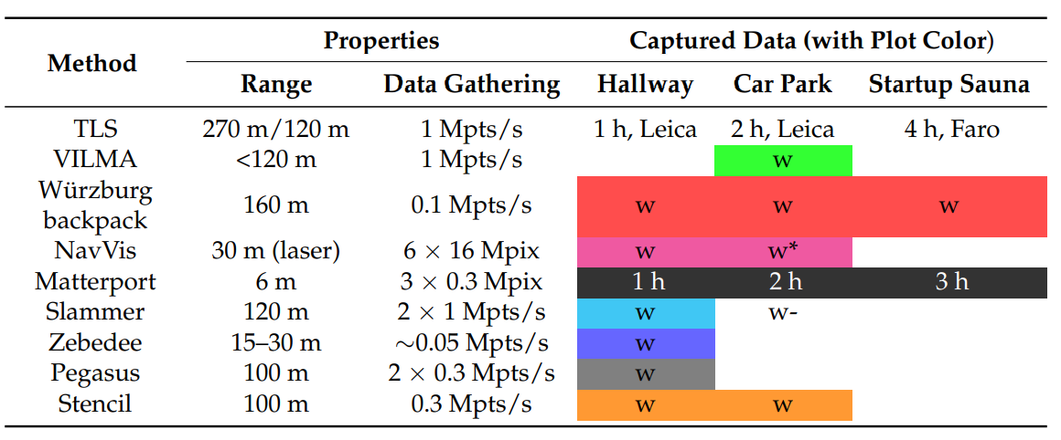
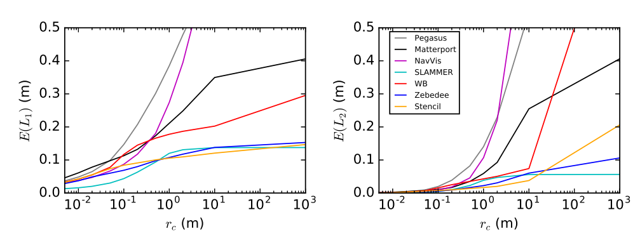
MLS (Mobile Laser Scanning) 2/2

Slide 13
Evaluation of Point Clouds
Control point approach
select control points
calculate Euclidean
Subset approach
extracting a subset of points
performing an analysis
Full point cloud approach

Slide 14
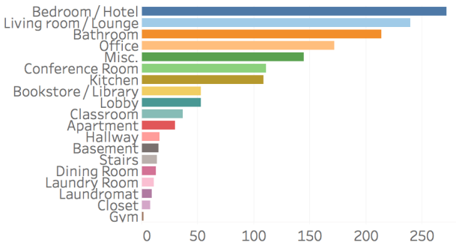
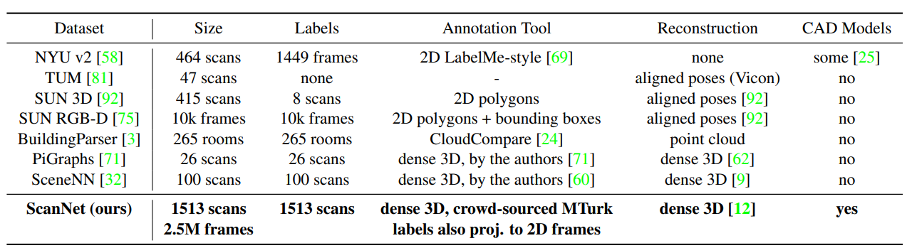
Dataset 1/2
ScanNet
www.scan-net.org
https://openaccess.thecvf.com/content_cvpr_2017/papers/Dai_ScanNet_Richly-Annotated_3D_CVPR_2017_paper.pdf
2.5M views in 1513 scenes, acquired in 707 distinct spaces, annotated with 3D camera poses, surface reconstructions, and semantic segmentations.

Slide 15
Dataset 2/2
ID | Name | Count of Scenes | Count of images | Category | URL
1 | NYU | 464 | 1449 | indoor
2 | KITTI |  | 93K | outdoor
3 | SUN RGBD |  | 10.335 | indoor | annotated for scene category, object detection, semantic segmentation
4 | SceneNet RGBD |  | 5M | indoor

Slide 16
Products

Slide 17
Reference
https://all3dp.com/1/best-3d-scanner-diy-handheld-app-software/

Slide 18
Structured Light
Shining3D EinScan SE / SP
IIIDScan PrimeSense 3D Scanner
Geometry camera: based on depth sensor 640x480
Texture camera
XYZPrinting Handheld
Based on Intel RealSense
Occipital Structure Sensor

Slide 19
Laser Triangulation
NextEngine 3D Scanner HD
max resolution: 0.1mm
FabScan Pi
Murobo Atlas
system: Raspberry Pi
BQ Ciclop
Arduino board
Logitech webcam

Slide 20
Photogrametry
3D Systems iSense

Slide 21
TOF
Microsoft Kinect （2nd version)
camera resolution: 1280x960

